Slide 1

BE AI&DS (2019 PATTERN) ELECT-IV – UI/UX DESIGN UNIT – I INTRODUCTION AND OVERVIEW OF UI CO1- UNDERSTAND THE PRINCIPLES OF USER INTERFACE
EMPOWERMENT THROUGH QUALITY TECHNICAL EDUCATION
AJEENKYA DY PATIL SCHOOL OF ENGINEERING, PUNE
MRS. ANKITA HARSHAD TIDAKE
ASSISTANT PROFESSOR
DEPARTMENT OF AI&DS
AJEENKYA DY PATIL SCHOOL OF ENGINEERING, PUNE

Slide 2
UNIT I – INTRODUCTION AND OVERVIEW OF UI
The Human –
I/P, O/P channels, Human Memory, thinking, emotion, individual difference (diversity), human psychology.
Introduction to User Interface Design (UI) –
The Relationship Between UI and UX, Roles in UI/UX, A Brief Historical Overview of Interface Design, Interface Conventions, Approaches to Screen Based UI, Template vs Content, Formal Elements of Interface Design, Active Elements of Interface Design, Composing the Elements of Interface Design, UI Design Process, Visual Communication design component in Interface Design , Application of UI design
Introduction to Design Technologies and Tools-
Sketch ,Wireframe ,Invision, Axure, Figma, Flutter, Mockups

Slide 3
Introduction
The human - central character in any discussion of interactive systems
The human, the user, is the one whom computer systems are designed to assist
The requirements of the user should therefore be our first priority
In this chapter we will look at areas of human psychology coming under the general banner of cognitive psychology

Slide 4
Input - Output Channels
A person’s interaction with the outside world occurs through information being received and sent: input and output
In an interaction with computer, user receives information that is output by computer and responds by providing input to computer
User’s output become computer’s input and vice versa
Input in human occurs mainly through the senses
Output through the motor control of the effectors
There are five major senses: sight, hearing, touch, taste and smell
Out of these, first three are most important to HCI
Similarly there are number of effectors, including the limbs, fingers, eyes, head and vocal system
In the interaction with computer, fingers play primary role, through typing or mouse control

Slide 5
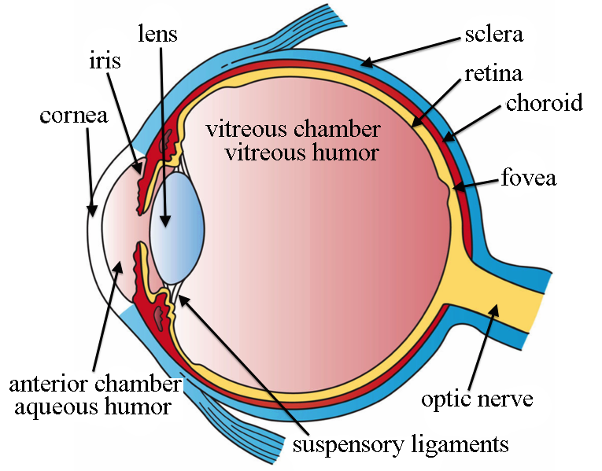
VISION
Human vision is a highly complex activity but it is the primary source of information for the person
Light is reflected from objects and their image is focused upside down on the back of the eye
Visual perception can be divided into two stages:
Physical reception of stimulus from the outside world
Processing and interpretation of that stimulus
Vision begins with light
Eye is a mechanism for receiving light and transforming it into electrical energy

Slide 6
HEARING – Human Ear
As vision begins with light, hearing begins with vibrations in the air or sound waves
Ear receives these vibrations and transmits them through various stages to the auditory nerves
Ear comprises three sections
Outer Ear
Middle Ear
Inner Ear
https://www.youtube.com/watch?v=98-6WfdumZY

Slide 7
HEARING – Human Ear
Outer ear is the visible part of the ear
It has two parts
Pinna - Structure that is attached to the sides of head
Auditory Canal – Structure in which sound waves are
passed to the middle ear
Middle ear is a small cavity connected to the outer ear by the tympanic membrane or ear drum and to the inner ear by the cochlea
Sound is changes or vibrations in air pressure

Slide 8
HEARING – Human Ear
It has a number of characteristics
Pitch - frequency of the sound
Low frequency produces a low pitch as well as for high
Loudness is proportional to amplitude of the sound; the frequency remains constant
Human ear can hear frequencies from 20 Hz to 15 kHz
Auditory system performs some filtering of sounds received, allowing us to ignore background noise and concentrate on important information

Slide 9
HEARING – Human Ear
Sound can convey notable amount of information
Rarely used in interface design, usually as warning sounds and notifications
Exception is multimedia which may include music, voice commentary and sound effects

Slide 10
TOUCH - Haptic Perception
Less important than sight or hearing
Provides vital information about environment
Experience of users of virtual reality games
Skin contains three types of sensory receptor:
Thermoreceptors respond to heat and cold
Nociceptors respond to intense pressure, heat and pain
Mechanoreceptors respond to pressure, concerned in
relation with HCI
https://www.youtube.com/watch?v=yU5kPoc7sL4

Slide 11
TOUCH - Haptic Perception
Two kinds of mechanoreceptor which respond to different types of pressure
Rapidly adapting mechanoreceptors respond to immediate pressure as the skin is indented
Also react more quickly with increased pressure
However, they stop responding if continuous pressure is applied
Slowly adapting mechanoreceptors respond to continuously applied pressure

Slide 12
Human Memory
Have you ever played the memory game?
Such games rely on our ability to store and retrieve information
This is the job of our memory system
Much of our everyday activity relies on memory
As well as storing all our factual knowledge, our memory contains our knowledge of actions or procedures

Slide 13
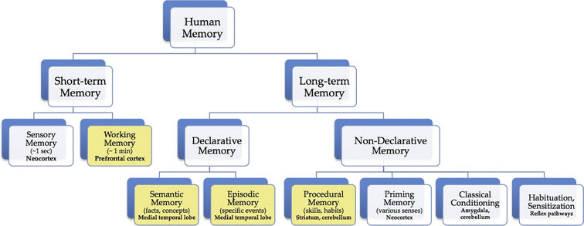
STRUCTURE OF HUMAN MEMORY

Slide 14
Sensory Memory
Act as buffers for stimuli received through senses
Exists for each sensory channel
Iconic Memory for Visual Stimuli
Echoic Memory for Aural Stimuli
Haptic Memory for Touch
These memories are constantly overwritten by new information coming in on these channels
Information is passed from sensory memory into short-term memory by attention
Attention is the concentration of the mind on one out of a number of competing stimuli or thoughts
It is clear that we are able to focus our attention selectively
This is due to the limited capacity of our sensory and mental processes
If we did not selectively attend to the stimuli coming into our senses, we would be overloaded

Slide 15
Short-term Memory
Acts as ‘scratch-pad’ for temporary recall of info
Used to store information which is only required quickly
Can be accessed rapidly, in the order of 70 ms
Also decays rapidly means information can only be held there temporarily in the order of 200 ms
Also has limited capacity

Slide 16
Long-term Memory
If short-term memory is our working memory, long- term memory is our main resource
Store factual information, experiential knowledge, procedural rules of behavior i.e. everything that we ‘know’
Differs from short-term memory in number of significant ways
Huge capacity
Relatively slow access time of approx. tenth of a second
Forgetting occurs more slowly in long-term memory

Slide 17
Long-term Memory
Information is placed from working memory through rehearsal
Two types of long-term memory
Episodic Memory - Represents our memory of events and experiences in serial form
Semantic Memory - structured record of facts, concepts and skills that we have acquired
https://online.seterra.com/en/vgp/3382
https://online.seterra.com/en/vgp/3369

Slide 18
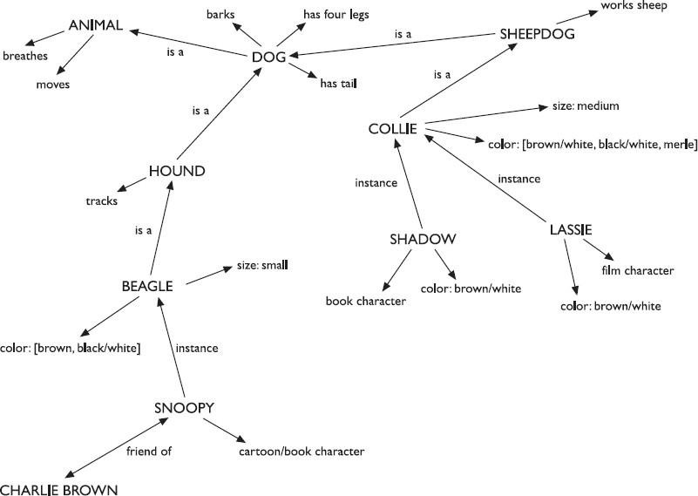
01-Aug-17
22

Slide 19
Human Emotions
Till now we saw about human perceptual and cognitive abilities
But human experience is more complex than this
Our emotional response to situations affects how we perform
For example, positive emotions enable us to think more creatively to solve complex problems
Whereas negative emotion pushes us into narrow, focused thinking
Sad, happy, fear, anger, affection, surprise, hate, disgust, nervous(anxiety),excitement, loneliness, satisfaction, shyness, awkwardness, proud, love, sympathy, empathy, aggression
Whatsapp- compulsive
Gpay- rewards- excitement, Satisfaction, happy,
Games- points/ bonus/ rewards- joy, proud, excitement, Satisfaction, aggression, nervous(anxiety)
Facebook- surprise, excitement, happy, loneliness, Sad….DEPRESSION
Instagram : business…. , excitement, Satisfaction, happy

Slide 20
Human Emotions
Problem may be easy to solve when we are relaxed, will become difficult if we are frustrated or afraid
So what are the implications of this for design?
In situations of stress, people will be less able to cope with complex problem solving or managing difficult interfaces
Whereas if people are relaxed they will be more forgiving of limitations in the design
This doesn’t give an excuse to design bad interfaces

Slide 21
Types of Human Emotions
Visceral
Behavioural
Reflective
- Don Norman
self-reflection
Apple: costly- easy to use app, trust, brand
CRED App
trust brand-→ proud:
Creta: proud,

Slide 22
Individual Differences
Till now we discussed humans in general
Made the assumption that everyone has similar capabilities and limitations
And can therefore make generalizations
To an extent this is true: psychological principles and properties apply to the majority of people
But all users are not same
Should be aware of individual differences during designs

Slide 23
Types of Individual Differences
long term
gender,
physical capabilities
intellectual capabilities
shorter term
effect of stress
weakness (Fatigue) on user
Changing Differences
Through time/ age
Through experience

Slide 24
Case Study: What predicts differences in performance
Experience
Technical aptitude
Age
Domain Specific knowledge
Personality
Affective factors- situational + emotional
System interaction practical
Domain Knowledge
Technical MCQs
Aptitute
Technical round-
programming
Aptitude Skill
Stress
BASIC INTELLIGENCE
IQ
36 lacs
3.6 lacs
individual

Slide 25
Psychology and Design
We saw how humans receive, process and store information, solve problems and acquire skill
In order to apply psychological principle in design, we need to understand its context in both terms,
Where it fits in the wider field of psychology
Details of the actual experiments
Fortunately, principles and results from research in psychology have been refined into
Guidelines for Design
Models to Support Design
Techniques for Evaluating Design

Slide 26
The 5 Dimensions of Interaction Design
The five dimensions of interaction design is a useful model for understanding what interaction design involves.
1D: Words
2D: Visual Representations
3D: Physical Objects or Space
4D: Time
5D: Behavior
https://uxplanet.org/how-animations-and-interactive-web-design-make-better-digital-products-e4c329e229fe

Slide 27
Interaction Styles
Command Line Argument
Form filling
Question answers
Menus
Direct Manipulation
WIMP
Point and Click
Natural Language
3 Dimentional- Virtual reality
https://www.youtube.com/watch?v=gSCiqgT4t_E

Slide 28
Command line interface
Way of expressing instructions to the computer directly
– function keys, single characters, short abbreviations, whole words, or a combination
suitable for repetitive tasks
better for expert users than novices
offers direct access to system functionality
command names/abbreviations should be meaningful!
Typical example: the Unix system

Slide 29
Menus
Set of options displayed on the screen
Options visible
less recall - easier to use
rely on recognition so names should be meaningful
Selection by:
numbers, letters, arrow keys, mouse
combination (e.g. mouse plus accelerators)
Often options hierarchically grouped
sensible grouping is needed
Restricted form of full WIMP system

Slide 30
Natural language
Familiar to user
speech recognition or typed natural language
Problems
vague
Ambiguous- confusion
hard to do well!
Solutions
try to understand a subset
pick on key words

Slide 31
Query interfaces
Question/answer interfaces
user led through interaction via series of questions
suitable for novice users but restricted functionality
often used in information systems
Query languages (e.g. SQL)
used to retrieve information from database
requires understanding of database structure and language syntax, hence requires some expertise

Slide 32
Form-fills
Primarily for data entry or data retrieval
Screen like paper form.
Data put in relevant place
Requires
good design
obvious correction facilities

Slide 33
Spreadsheets
first spreadsheet VISICALC, followed by Lotus 1-2-3
MS Excel most common today
sophisticated variation of form-filling.
grid of cells contain a value or a formula
formula can involve values of other cells
e.g. sum of all cells in this column
– user can enter and alter data spreadsheet maintains consistency

Slide 34
Point and click interfaces
used in ..
multimedia
web browsers
hypertext
just click something!
icons, text links or location on map
minimal typing

Slide 35
WIMP Interface
Windows
Icons
Menus
Pointers
… or windows, icons, mice, and pull-down menus!
default style for majority of interactive computer systems, especially PCs and desktop machines

Slide 36
Three dimensional interfaces
virtual reality
‘ordinary’ window systems
highlighting
visual affordance
indiscriminate use
flat buttons …
click me!
just confusing!
3D workspaces
… or sculptured
use for extra virtual space
light and occlusion give depth
distance effects

Slide 37
elements of the wimp interface
windows, icons, menus, pointers
+++
buttons, toolbars, palettes, dialog boxes
also see supplementary material on choosing wimp elements

Slide 38
Windows
Areas of the screen that behave as if they were independent
can contain text or graphics
can be moved or resized
can overlap and obscure each other, or can be laid out next to one another (tiled)
scrollbars
allow the user to move the contents of the window up and down or from side to side
title bars
describe the name of the window

Slide 39
Icons
small picture or image
represents some object in the interface
often a window or action
windows can be closed down (iconised)
small representation ﬁ many accessible windows
icons can be many and various
highly stylized
realistic representations.

Slide 40
Pointers
important component
– WIMP style relies on pointing and selecting things
uses mouse, trackpad, joystick, trackball, cursor keys or keyboard shortcuts
wide variety of graphical images

Slide 41
Menus
Choice of operations or services offered on the screen
Required option selected with pointer
File Edit Options |  | Font
 | Typewriter Screen Times
problem – take a lot of screen space
solution – pop-up: menu appears when needed

Slide 42
Kinds of Menus
Menu Bar at top of screen (normally), menu drags down
pull-down menu - mouse hold and drag down menu
drop-down menu - mouse click reveals menu
fall-down menus - mouse just moves over bar!
Contextual menu appears where you are
pop-up menus - actions for selected object
pie menus - arranged in a circle
easier to select item (larger target area)
quicker (same distance to any option)
… but not widely used!

Slide 43
Menus extras
Cascading menus
hierarchical menu structure
menu selection opens new menu
and so in ad infinitum
Keyboard accelerators
key combinations - same effect as menu item
two kinds
active when menu open – usually first letter
active when menu closed – usually Ctrl + letter
usually different !!!

Slide 44
Menus design issues
which kind to use
what to include in menus at all
words to use (action or description)
how to group items
choice of keyboard accelerators

Slide 45
Buttons
individual and isolated regions within a display that can be selected to invoke an action
Special kinds
radio buttons
set of mutually exclusive choices
check boxes
set of non-exclusive choices

Slide 46
Toolbars
long lines of icons …
… but what do they do?
fast access to common actions
often customizable:
choose which toolbars to see
choose what options are on it

Slide 47
Palettes and tear-off menus
Problem
menu not there when you want it
Solution
palettes – little windows of actions
– shown/hidden via menu option
e.g. available shapes in drawing package
tear-off and pin-up menus
– menu ‘tears off’ to become palette

Slide 48
Dialogue boxes
information windows that pop up to inform of an important event or request information.
e.g: when saving a file, a dialogue box is displayed to allow the user to specify the filename and location. Once the file is saved, the box disappears.

Slide 49
interactivity
easy to focus on look what about feel?

Slide 50
Speech–driven interfaces
rapidly improving …
… but still inaccurate
how to have robust dialogue?
… interaction of course!
e.g. airline reservation: reliable “yes” and “no”
+ system reflects back its understanding
“you want a ticket from New York to Boston?”

Slide 51
Look and … feel
WIMP systems have the same elements:
windows, icons., menus, pointers, buttons, etc.
but different window systems
… behave differently
e.g. MacOS vs Windows menus
appearance + behaviour = look and feel

Slide 52
Initiative
who has the initiative?
old question–answer WIMP interface
computer
user
WIMP exceptions …
pre-emptive parts of the interface
modal dialog boxes
come and won’t go away!
good for errors, essential steps
but use with care

Slide 53
Error and repair
can’t always avoid errors …
… but we can put them right
make it easy to detect errors
… then the user can repair them
hello, this is the Go Faster booking system what would you like?
(user) I want to fly from New York to London you want a ticket from New York to Boston (user) no
sorry, please confirm one at a time
do you want to fly from New York (user) yes
… … …

Slide 54
Context
Interaction affected by social and organizational context
other people
desire to impress, competition, fear of failure
motivation
fear, allegiance, ambition, self-satisfaction
inadequate systems
cause frustration and lack of motivation

Slide 55
Introduction to Design Technologies and Tools Sketch ,Wireframe ,Invision, Axure, Figma, Flutter, Mockups
Why Are UI/UX Tools Essential for Designers?
User Interface (UI) involves the creation of an interface with components aimed at enhancing comprehension. At the same time, User Experience (UX) concentrates on delineating the user’s path to craft an impeccable digital product. Presently, numerous software options in the market designated as UI/UX tools serve a dual purpose. They execute specific functions related to both processes.
For designers perusing this information, it is crucial to note that despite the versatility of UI/UX design tools, proficiency in each of these processes should still be cultivated independently. Becoming adept in multiple tools may require considerable time and dedication.

Slide 56
1. Adobe XD
As the foremost authority in cutting-edge UX tools for creative minds, Adobe XD stands out, offering a robust solution to assist you in crafting, prototyping, sharing, and collaborating seamlessly within their high-caliber application. This platform empowers you to fashion a master element with tailor-made properties, ensuring seamless integration across your website or application.
Key Features:
Revamp the core element and disseminate it throughout the entire organization.
Benefitting from enhanced vector tools, the adept resizing of assets that seamlessly adjusts across various platforms, and the inclusion of layout grids for meticulous design.
They are tailored for designers within expansive organizations and enterprises seeking uniformity in their visual assets.
Boasting an asset library facilitates swift alterations to graphics and styles, not to overlook the Repeat Grid feature empowering designers to establish a consistent style and, for instance, effortlessly replicate a contact list or a photo gallery as often as required.
Suitable for: Prototyping, Designing
Works on: Windows and macOS
Free trial/version available: Yes

Slide 57
2. Mockplus
Mockplus stands out as a premier online UX tool, facilitating seamless collaboration between designers and developers. This tool expedites the creation of interactive prototypes of any fidelity, enabling designers to efficiently share, test, and iterate with their teams, thereby accelerating the entire product design workflow by a minimum of 200%.
Equipped with a prototyping tool boasting an extensive array of over 3000+ built-in design elements and templates, Mockplus empowers designers to translate their ideas into visual representations within minutes. The robust asset libraries provided by the tool make it effortless to design UI layouts and patterns, offering the advantage of reusing them consistently across pages, prototypes, and different teams.
Mockplus excels in fostering cross-team collaboration. Not only does it enable designers to streamline their workflow, but it also provides developers with a code-free and pixel-perfect design process, eliminating any potential chaos.
Key Features:
It provides a no-code interface for expressing ideas through a simple drag-and-drop mechanism.
An extensive collection of pre-built UI widgets and templates
It enables collaborative co-designing of projects by your entire team simultaneously, with automatic synchronization of all edits.
Facilitates the export of your prototype to an HTML demo package or any desired image format.
Offers plugin support for Axure, Sketch, Adobe Photoshop, Figma, and Adobe XD, allowing the prototyping of projects across various platforms.
It empowers developers to quickly inspect, copy, and download design specifications, assets, and code snippets with a single click.
It provides the capability to preview and test your web and app prototypes directly on real devices.
Suitable for: Wireframing, prototyping, mockup, animation, and UI designing
Works on: Browser, macOS and Windows
Free trial/version available: Yes

Slide 58
3. Sketch
Sketch stands as a recognized standard in UX tools for crafting high-fidelity prototypes and interfaces, providing an immediate preview on mobile devices. The inclusion of a Symbols feature facilitates the generation of reusable UI elements.
This functionality enables the construction of design systems, promoting consistency in interface design. Additionally, it allows the exportation of the design into a fully functional prototype. Notably, there is no provision for a complimentary version or trial in its offerings.
Key Features:
Utilizing this design and prototyping tool empowers users to generate mockups and distribute them among team members for input.
Incorporate images and personalize the text to obtain a precise representation of the final product.
This tool is advantageous for UX designers across all proficiency levels, particularly those seeking feedback from various team members.
Sketch boasts an extensive user community and numerous integrations, simplifying the onboarding process.
Suitable for: Prototyping, Design
Works on: MAC
Free trial/version available: No

Slide 59
4. InVision
InVision offers a trio of UI/UX design tools, presenting users with a unified platform for collaborative efforts and the swift creation of screen designs through prototyping. The accessibility of all prototypes, sketches, and designs in a single location is facilitated by InVision Cloud.
This tool is highly suggested for UX designers at various skill levels, as well as their counterparts within the product marketing organization, to expedite the process of prototyping and obtaining approval.
Key Features:
The Studio platform provides the capability to swiftly prototype user experience feedback software utilizing vector-based drawing features and an elegant solution for rapidly generating responsive designs tailored for any screen.
Executes screen transitions that replicate user navigations.
It boasts multiple API integrations, enabling seamless connections with tools and media libraries already in use.
InVision Design System Manager (DSM) serves as a content management library, serving as the singular source of truth for a company’s most current brand assets.
It facilitates the organization of approved assets for the content marketing team.
Within the DesignBetter.Co portal, InVision offers valuable books, podcasts, and workshops for designers seeking to enhance their skills.
Suitable for: Prototyping, UI Designing
Works on: MAC OS
Free trial/version available: Yes

Slide 60
5. Maze
Maze stands out as another remarkable tool for user interface (UI) design in our lineup. It functions as swift testing software, facilitating comprehensive testing with or without prototypes. This software for designing applications proves to be an excellent resource for validating concepts and mobile app ideas. It accommodates various testing types at any phase of the development process.
Key Features:
Facilitates usability testing for obtaining comprehensive user insights through the use of open-ended follow-up inquiries.
It permits the computation of quantitative metrics such as A/B tests, misclick rates, success rates, and page heatmaps.
It provides an array of integrations with external tools like InVision, Marvel, Sketch, Adobe XD, and Figma.
Suitable for: Rapid prototype testing, Usability testing, A/B testing, Remote testing
Works on: Browsers
Free trial/version available: Yes

Slide 61
6. Axure
Axure RP’s UI design tool enables swift prototyping with realistic functionality, courtesy of its dynamic content, conditional logic, and adaptive views features. Integration with well-known design tools like Sketch facilitates seamless design sharing with stakeholders.
This tool is remarkably suggested for project managers who need more design or coding skills. Documenting issues within the platform becomes effortless, ensuring alignment toward a common objective.
Key Features:
Utilizing the Axure Cloud feature enables the swift sharing of prototypes across the whole organization, facilitating immediate feedback.
Integration with Slack and Microsoft Teams ensures that your organization remains informed about the most recent changes.
Facilitating the designer-to-developer handoff, the publication of Axure RP files to Axure Cloud includes documentation and prototypes, streamlining the process.
Upgrading provides co-authoring capabilities, revision history, and team hosting on Axure Share.
Additionally, it offers the capacity to hand over a project to the developer team with comprehensive documentation, catering to UX designers who prefer to avoid directly engaging with code.
Suitable for: Prototyping
Works on: Windows and macOS
Free trial/version available: Yes

Slide 62
7. Figma
Figma stands out as a premier UI design tool, featuring an intuitive drag-and-drop interface editor that facilitates seamless collaboration across your entire organization. Unlike many UX tools, Figma excels in bridging the divide between designers, developers, and project managers.
Designers benefit from Figma’s robust features, such as the ability to constrain graphical elements to specific on-screen positions, Boolean operations for precise combinations of multiple shapes, and 60fps interactive editing for a clear preview of your design. This tool proves invaluable for UX designers in larger organizations, enabling them to expedite the design process alongside developers and project managers.
Key Features:
Takes pride in being the singular, authoritative source for an organization, enabling the uploading of sanctioned reusable elements/icons, fonts, and styles.
The developer workflow empowers team members to scrutinize code and extract visual assets and CSS directly from the design file.
Possesses the capability to seamlessly integrate with the organization’s identity provider through SAML-based Single Sign-On (SSO) integrations.
Figma showcases case studies featuring collaborations with notable companies such as GitHub, Square, and Uber.
Suitable for: Design
Works on: Browser, macOS, and Windows
Free trial/version available: Yes

Slide 63
8. Marvel
Marvel stands out as a leading UI/UX design tool, ideal for crafting diverse lo-fi and hi-fi wireframes and prototypes and facilitating HTML and CSS handovers. It proves to be an exceptional tool for enhancing the prototype interface, giving it the appearance of a polished final product.
The learning curve for this application design software is minimal, adding to its effectiveness in the seamless creation of prototypes and efficient design of interfaces.
Key Features:
Facilitates swift prototyping, handoff, and testing.
It presents a straightforward method for generating pages and even emulating your design through a prototype.
Includes valuable integrations such as Sketch, Jira, Maze, Smartmockups, and others, allowing seamless incorporation of your designs into the project workflow.
It provides a variety of tools tailored to each stage of the design process.
It facilitates the creation of prototypes through gestures like swipe, pinch, and tap.
Permits the addition of screen elements, importation of designs, and numerous other features to enhance your prototypes.
The Handoff feature accommodates the HTML code and CSS styles essential for developers to initiate prototype development.
It extends support for interactivity and animations.
Suitable for: Prototyping, Designing, Wireframing, Animation
Works on: Web, iOS, and Android
Free trial/version available: Yes

Slide 64
9. Balsamiq
A beloved wireframing tool among designers, product managers, and innovators, Balsamiq stands out as one of the finest UI design software options. Specifically crafted to generate low-fidelity wireframes, Balsamiq facilitates users and testers in concentrating on the usability and flow of the interface.
Despite its simplicity, this tool comes highly recommended for UX designers of all expertise levels, enabling a swift demonstration of the usability of a proposed site or application.
Balsamiq proves beneficial for product managers and entrepreneurs seeking to translate their ideas from thoughts to paper. With a straightforward learning curve, even individuals lacking coding knowledge can effectively utilize this design software.
Key Features:
Assists in crafting low-fidelity wireframes to emphasize functionality and user flow.
It provides a user-friendly drag-and-drop editor for effortless and straightforward design.
Includes a repository of tools and reusable icons, empowering designers to select and generate compelling real-time mockups.
It permits the incorporation of links into interactive prototypes for demonstrations or usability testing.
It facilitates the showcasing of wireframes on the internet through images and interactive PDFs.
It offers a 30-day complimentary trial period.
Suitable for: Mockups, Prototyping, Wireframing
Works on: Browser, macOS, and Windows
Free trial/version available: Yes

Slide 65
10. Origami Studio
In contrast to alternative UX design tools such as InVision, Origami Studio stands out as an exceptionally advanced software crafted explicitly for professionals. Initially developed for designers at Facebook, it is now accessible for free.
Origami Studio possesses a learning curve, transforming it into a sophisticated prototyping tool suitable for beginners. Positioned as one of the cutting-edge UX tools available, it facilitates lifelike interactions and provides smooth integration with Sketch.
Key Features:
Establish the rationale behind prototypes through the utilization of its patch editor.
It provides an extensive patch library, available for users in real-time.
Seamlessly duplicate and transfer layers from Sketch without experiencing any interruptions.
It serves as a comprehensive tool for the processes of prototyping, designing, and animation.
Facilitates the effortless editing of dynamic layouts.
It exhibits excellent integration capabilities with both Sketch and Figma.
Suitable for: Prototyping, Designing, Animation
Works on: macOS, Android, and iOS devices
Free trial/version available: Yes

Slide 66
How do you pick the right UI/UX design tool?
When selecting the appropriate UI/UX design tool, consider the following factors during the shortlisting process.
For Prototyping:
Examine features like a no-code interface, easy export and sharing functions, animations, and support for responsive design.
For Wireframing:
Choose tools that provide free components such as icons, shortcuts for processes, and straightforward controls.
For Mockups:
Ensure that the chosen tool offers numerous built-in tools for designing recreations.
For Collaboration:
As design is a collaborative effort, opt for a tool that supports project collaboration, allowing for commenting, tagging, and marking.
Plugins:
Check for plugin support in your chosen tool, enabling designers to extend functionality when certain required functions are missing.
UI Kits and Resources:
Save time by selecting a tool with UI Kits and resources, such as templates, themes, etc., to expedite the design process.
Integrations:
Choose a UI/UX design tool with integrations to streamline processes and facilitate seamless data sharing between platforms like CRM, Cloud, etc., ensuring efficiency in the overall design process.

